Slide 1
Student grade calculator Presented by : Manvitha pai(4MW23CS068) Rakshita raykar(4MW23CS113) Parineeta(4MW23CS090)

Slide 2
INTRODUCTION
A Student Grade Calculator is a database-driven software system designed to help educators and institutions manage, calculate, and analyze students’ academic performance efficiently. It uses a database to store and retrieve data related to students, courses, grades, and performance metrics.

Slide 3
Problem statement
In many educational institutions, the process of managing student grades and calculating academic performance is still done manually or using basic tools like spreadsheets. This leads to several issues including:
Increased likelihood of human error during grade entry and calculations Difficulty in maintaining consistent and secure academic records Time-consuming report generation and student evaluation Lack of centralized data access for faculty, administrators, and students.
The Student Grade Calculator using DBMS addresses these challenges by offering a structured, reliable, and user-friendly system that simplifies grade management and enhances the overall academic process.

Slide 4
Modules / Methodology

Slide 5
Student Module : Handles student registration, profile updates, and viewing of grades and academic reports. Course Module: Manages course creation, including course code, title, credit hours, and linking students to courses.
Grade Entry Module : Allows authorized users (e.g., faculty) to input and update internal and external assessment grades. Result Calculation Module : Automatically computes GPA and CGPA based on predefined grade point logic and course credits. Database Module : Maintains normalized tables (Students, Courses, Grades, Results) and ensures data integrity through primary and foreign keys. Report Generation Module: Produces printable mark sheets, transcripts, and performance analytics by querying the database. Security & Access Control Module: implements user authentication and role-based access to ensure that only authorized personnel can make data changes.

Slide 6
Literature review
1. Academic Automation Tools: Researchers have proposed automated grading systems that replace manual processes with digital ones, citing increased accuracy and efficiency. 2. Role of DBMS in Academic Systems: Studies show that using relational databases enables secure storage of student records, efficient query processing, and accurate grade computations. 3. Normalization and Data Design: Literature highlights the importance of normalization in maintaining data integrity in student information. 4. Web-Based Grade Calculators: Recent papers describe the integration of DBMS with web technologies to allow remote grade entry, result viewing, and report generation. 5. Security and Access Control: Scholars emphasize the implementation of role-based access and encryption to protect sensitive academic data, making DBMS a secure backbone for student evaluation systems.

Slide 7
FUTURE ENHANCEMENT
Voice-Activated Grade Entry : Allow faculty to enter and manage grades through voice commands using NLP-powered interfaces.
Auto-Adaptive Curriculum Engine : Based on real-time student performance , the system could adjust syllabus pace and difficulty automatically.
AI-Powered Peer Evaluation System : Implements a system where AI moderates and validates peer assessments for group projects or presentations.
Predictive Dropout Prevention System : Advanced AI models could detect subtle patterns indicating risk of dropout and trigger automated support interventions.

Slide 8
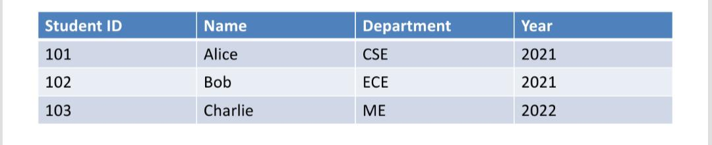
Key Components of a student grade Database
1. Student table

Slide 9
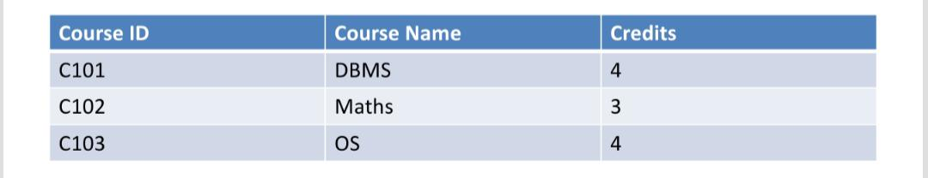
2.Course table

Slide 10
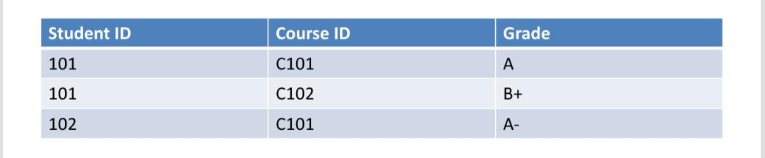
3. Grade table

Slide 11
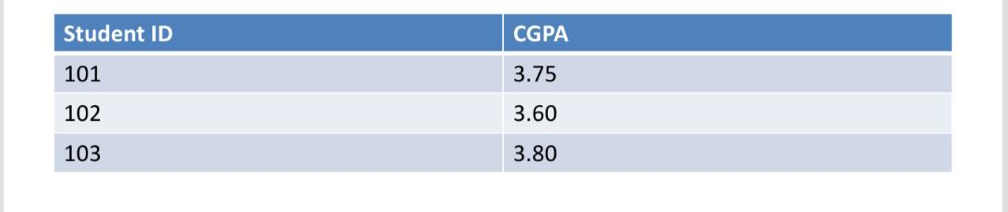
4. Result table

Slide 12
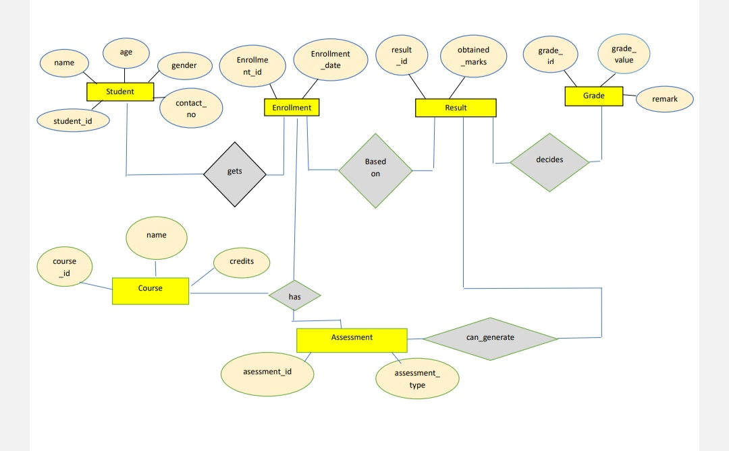
Er diagram

Slide 13
Conclusion
The Student Grade Calculator using DBMS is an efficient, reliable, and scalable solution for automating academic performance tracking and grade management. By leveraging a structured database system, the project minimizes manual effort, reduces errors, and provides real-time access to student records and academic analytics.
Overall, the project demonstrates how database management systems can be effectively utilized in educational settings to enhance operational efficiency and academic transparency.

Slide 14
Reference
Batini, C., Ceri, S., & Navathe, S. B. (1992). Conceptual Database Design: An Entity-Relationship Approach. Benjamin/Cummings.
Srivastava, A., & Garg, A. (2015). Automation in educational institutions using ERP. International Journal of Computer Applications, 113(1), 30–34. Silberschatz, A., Korth, H. F., & Sudarshan, S. (2020). Database System Concepts (7th ed.). McGraw-Hill Education.
IEEE Research Paper: “Design and Implementation of Student Grade Management System Based on SQL Server” – IEEE Xplore Digital Library https://ieeexplore.ieee.org/document/9444050

Slide 15
Thank you

